Slide 1
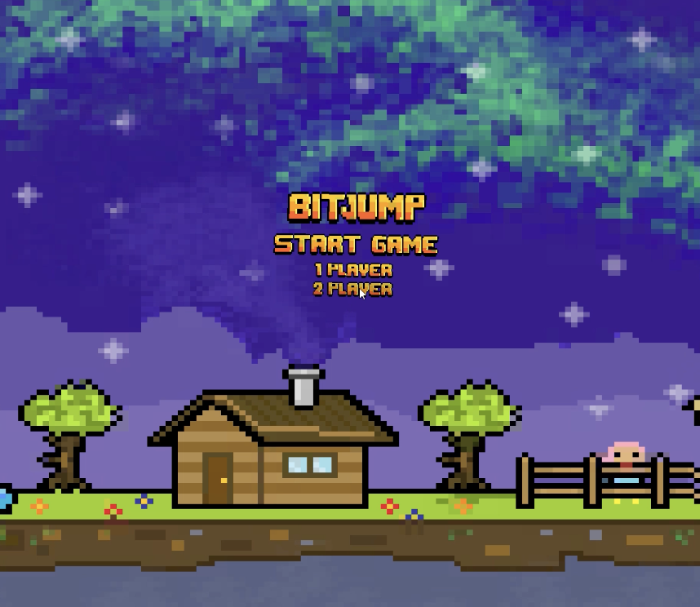
BITJUMP
Multiplayer Networked Game

Slide 2

Content
Background and Context
Aims and objectives
Preparing Unity for Photon Networking
Photon Application in Unity Games
Video Demonstration
Loading Screens and Error Handling
Scene Management and Synchronization

Slide 3
Background and context
My inspirations sparked off both primary and secondary research means.
The demographics reveal that platformer games were popular, with the corresponding figure suggesting most gamers being born during the genre's surge in popularity.
The ideology of gaming has always been a dynamic force, consistently evolving, with further research on new innovative strategies, which I wanted to contribute to.

Slide 4
Aims and Objectives
In-depth analysis of previous literature regarding networking frameworks and their integration into game-engines.
01
Further research into optimal game mechanics, and how multiplayer can be integrated successfully.
02
Develop a seamless multiplayer title, providing users enjoyability and contributing my own technical analysis to the field of game-dev.
03

Slide 5
Comparison of Networking Framework
The table below indicates that Photon and Mirror are optimal frameworks, offering advantages over competitors. This report will specifically focus on Photon due to the simplicity of integration into a Unity environment.
Feature | Photon PUN | Mirror | UNET | FishNet
Documentation | Extensive | Extensive | Extensive | Limited
Ease of Use | Beginner-friendly | Beginner-friendly | Beginner-friendly | Intermediate
Network Architecture | Client-server | Client-server | Client-server | Client-server
Protocol | UDP | UDP | UDP | UDP
Latency Handling | Good | Good | Good | Good
Reliability | High | High | High | Medium
Scalability | High | High | Medium | Medium
Community Support | Strong | Strong | Strong | Limited
Price | Freemium model with paid plans | Open-source with paid support plans | Server hosting $5 a day dependant on CCU. | Free and open source

Slide 6

Preparing Unity for Photon Networking
For Unity to work with Photon, the Photon PUN 2 package will need to be imported from the Unity Assets Store.
Photon will then require slight configuration, including the setup of a new App ID on their website
This would then allow for the Photon. PUN library to be used within scripts, which opens to an array of different networking functions.

Slide 7
Photon Application in Unity Games
Within BitJump, Photon was responsible for the creation of Nicknames unique to each user, connecting users between servers, and synchronizing player movement and animations.
This was achieved through a variety of Photon components, being PhotonView, PhotonAnimatorView, PhotonTransformView and RPC calls.

Slide 8
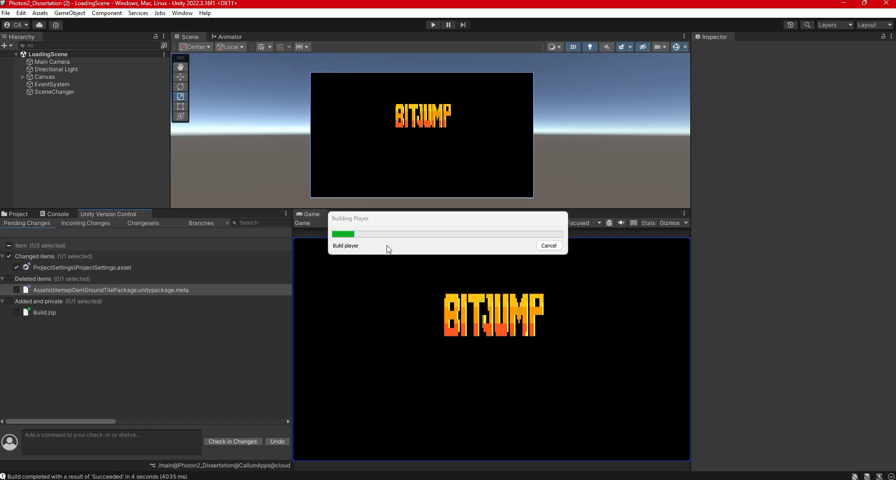
Video Demonstration

Slide 9
Loading Screens and Error Handling
Loading Screens were implemented between scenes to ensure that each client has connected to the Photon Servers, this was required to handle the error of users not being connected prior to creation or joining of a game.
Error handling was also a requirement within my application, this would reduce the odds of the game crashing when a user does an action that would throw an error, instead a dismissible error message displays onto the players UI, e.g. ”Game is full” “Waiting for Host”.
This was also used to stop errors from being thrown when players who aren't the host try to launch the game.

Slide 10
Scene Management and Synchronization
To ensure seamless multiplayer gameplay, the Photon component: Photon.LoadLevel() and Photon.AutomaticallySyncScene, had to be utilized.
This would ensure that the scenes are synced across the server to all clients, rather than just one client transitioning to the next scene, both would transition.

Slide 11
Discussion and Results
After development and research was complete, results were composed of a fully functional multiplayer title (BitJump) incorporating innovative features such as seamless multiplayer and integration of the ChatGPT API.
In addition to this, further analysis were conducted to evaluate user feedback, therefore refining the multiplayer experience for optimal enjoyment and engagement.
Previous literature was also reviewed, leading to an understanding of optimal networking frameworks and their application into a Unity environment.

